Slide 1

Basic Unit Testing

Slide 2

Agenda
Fundamentals
Manual vs automated testing
Breaking external dependencies
Q&a

Slide 3
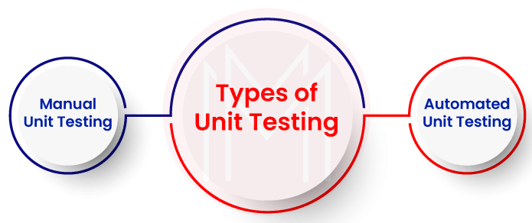
Fundamentals
Definition: The practice of writing code to test our code, and then run those tests in an automated fashion

Slide 4
Manual Testing
Manual testing
Launch the application
Login
Fill out a form
Submit it
Verify the result
repeat all steps

Slide 5
Automated Testing
With automated unit testing you write code and directly call it with different inputs and verify that the return value is correct.
Automated tests are repeatable
Rerun when:
Changes are made
Code is committed to repository
Benefits:
Test your code frequently in less time
Catch bugs before deploying – refactor and deploy with confidence
Reduce number of bugs and increase the quality of your software
* Refactoring means changing the structure of the code without changing its behavior

Slide 6
Automated Testing
Tests should be small, have one single responsibility and no logic
How a test method should be named:
[MethodName]_[Scenario]_[ExpectedBehavior]
Don’t test:
Language features
3rd-party code

Slide 7
Breaking external dependencies
Unit tests should not touch external resources
MathOperations
File
public interface IFileService
{
void AppendLine(string path, string content);
}
public interface FileService : IFileService
{
public void AppendLine(string path, string content)
{
// Implementation
}
}

Slide 8
Q&A

Slide 9

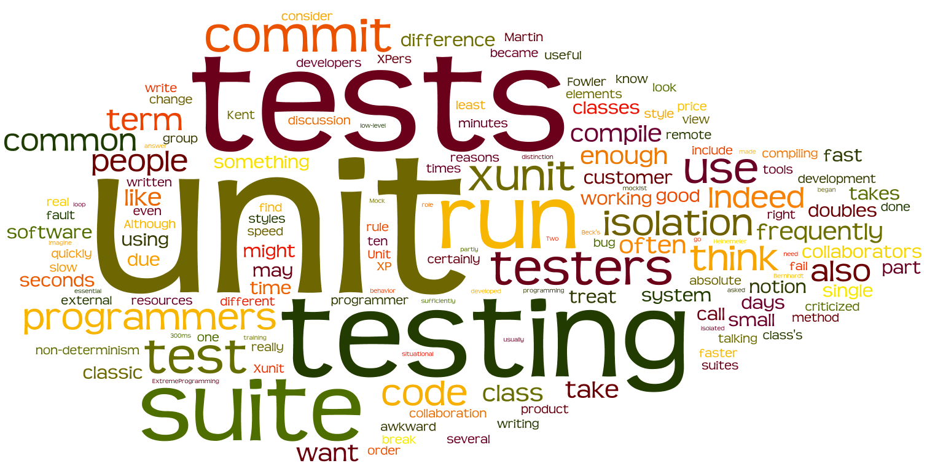
Thank you!
Alexandru Olaru
mircea-alexandru.olaru@endava.com

